Slide 1




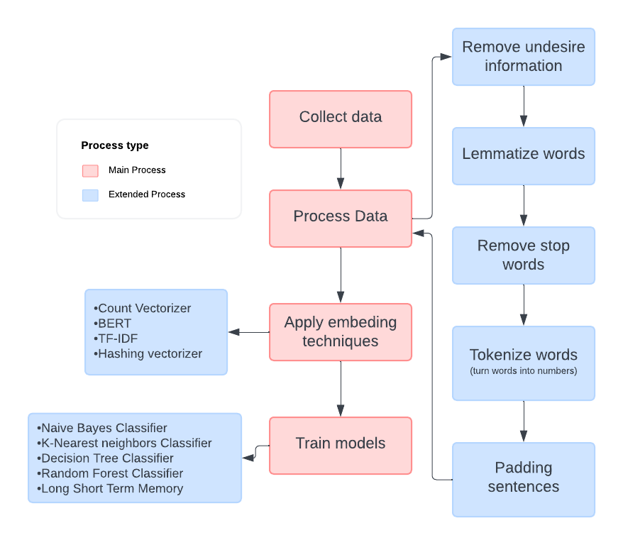
Spam Classification of SMSs using Machine Learning Techniques
Armando Orozco, Santa Ana College
Dr. Doina Bein, Department of Computer Science, California State University, Fullerton
Background
Methods (continued)
The advent of machine learning has revolutionized the way we approach text classification, particularly in the Short Message Service (SMS) domain. This research explores different machine learning algorithms and techniques to analyze their effects on sentiment recognition, specifically if an SMS message is undesirable. An undesired message that could possibly be malicious is called . The goal is to apply and analyze sophisticated machine learning techniques to classify SMS content into Spam, or not Spam (Ham) and analyze the effects that every single technique has and if it is suitable to implement in a day-day application.
Embedding: The process of embedding is the process to give sentiment to words and thus sentences, there are several techniques to give sentiment to words, and a handful of them were applied to observe their effects during the training. The techniques that were applied were:
Count Vectorizer
BERT
TF-IDF
Hashing vectorizer
Model selection and training
After the text preprocessing was done, different models, with each of the different embedding techniques were trained, the types of models that were used are:
Naive Bayes Classifier
K-Nearest neighbors Classifier
Decision Tree Classifier
Random Forest Classifier
Long Short Term Memory (Recurrent Neural Network)
Methods
Software libraries, tools, and languages
As with almost any project a handful of software libraries and tools were used to realize the experiments, first as an IDE (Integrated Development Environment) Jupyter Notebook was used and Visual Studio code as an editor. The programming language used was Python, and libraries such as Pandas for data management, NumPy for some mathematical operations, matplotlib to plot graphs, scikit-learn, and Tensorflow for machine learning models. Some NLP techniques, and finally, NLTK provided some NLP tokenization techniques specific to the ‘TweetTokenizer’, and the virtual dictionary ‘WordNet’.
Data collection
Data was collected from the UCI machine learning repository and a paper by Mishra, S, & Soni. The second dataset is simplified by removing the 'URL', 'PHONE', and 'EMAIL' columns, as the focus is on NLP techniques without external information.
Natural Language Processing (NLP) techniques
The NLP techniques are used to preprocess human language (in this case English) and turn it into an understandable computer language, like numbers, and then these numbers will be fed into the machine learning model to make predictions. There are several steps to follow and the order that was taken for this research was the next one:
Tokenization*: The process consists of turning sentences into a list of words, during this process the ‘TweetTokenizer’ from NLTK, was used. This tokenized specializes in short conversations like tweets, as the name says. Tweets can be similar to short text messages (SMS), as both can include, links, words that are outside of the English dictionary, or different symbols used to give meaning to something. After being separated into words these were turned into numbers so the computer could understand.
Lemmatization: The lemmatization of a word is the process by which a word is converted to its base form, this process uses a pontificated process that analyzes the word’s morphology using vocabulary from a dictionary. The library NLTK provides the functions to lemmatize words, and also uses the virtual dictionary ‘WordNet’.
Word Stop removal: This step consisted in removing all the stop words, from the sentences such as “the”, “a” or “an”, this was done to focus on the more meaningful text.
Tokenization*(continued): After the words were lemmatized and the stop words were removed, the remaining words were turned into numbers, for example. The word “hello” = 1, and “book” = 2, this would be repeated with all words. After every word was assigned a number, all sentences were rewritten with their respective word-to-number translation
Padding: After the tokenization and the lemmatization, the sentences need to be converted to lists of the same length, a padding algorithm was provided by the TensorFlow library
Conclusion
(Analyze and interpret your results and how it supports your hypothesis. You can also state any sources of error or limitations you encountered. You can state your conclusion in bullet format if necessary.)
Future Work
d
(You can state any future procedures or ideas that would help your experiment reach its goal or further advance it.)
References
Bird, Steven, Edward Loper and Ewan Klein (2009), Natural Language Processing with Python. O’Reilly Media Inc
Almeida,Tiago and Hidalgo,Jos. (2012). SMS Spam Collection. UCI Machine Learning Repository. https://doi.org/10.24432/C5CC84.
Mishra, S., & Soni, D. (2020). Smishing Detector: A security model to detect smishing through SMS content analysis and URL behavior analysis. Future Generation Computer Systems, 108, 803-815.
Devlin, J., Chang, M. W., Lee, K., & Toutanova, K. (2018). Bert: Pre-training of deep bidirectional transformers for language understanding. arXiv preprint arXiv:1810.04805.
Results
(Present the results you obtained in text, graphs, and/or images.
Do not analyze. Be sure to include figures for graphs and images that briefly state the procedure completed and discuss the results of that procedure.
Present results in a story-like manner, which results were obtained first, second, and so on.
Don’t worry if you did not obtain many results or “bad” results. Any result is a good result.)
Acknowledgements
Project supported by Project RAISER, U.S. Department of Education HSI-STEM award P031C210118.
Notes:
Here you can introduce yourselves, your topic and your hypothesis.

